Slide 1
Study of projectile fragmentation reactions and
production of nuclei near the neutron drip line
2022.02.28.
D.G. Kim

Slide 2
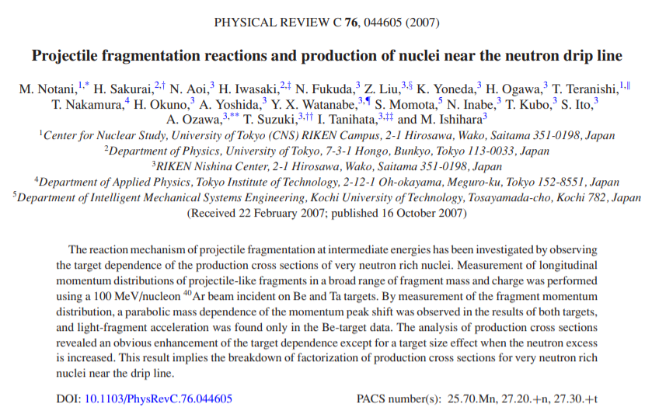
M. Notani et al., PhysRevC.76.044605 (2007)
(목표)
LISE++ Projectile Fragmentation 모델 이해
1. Production Cross Section (XS)
2. Momentum distribution

Slide 3
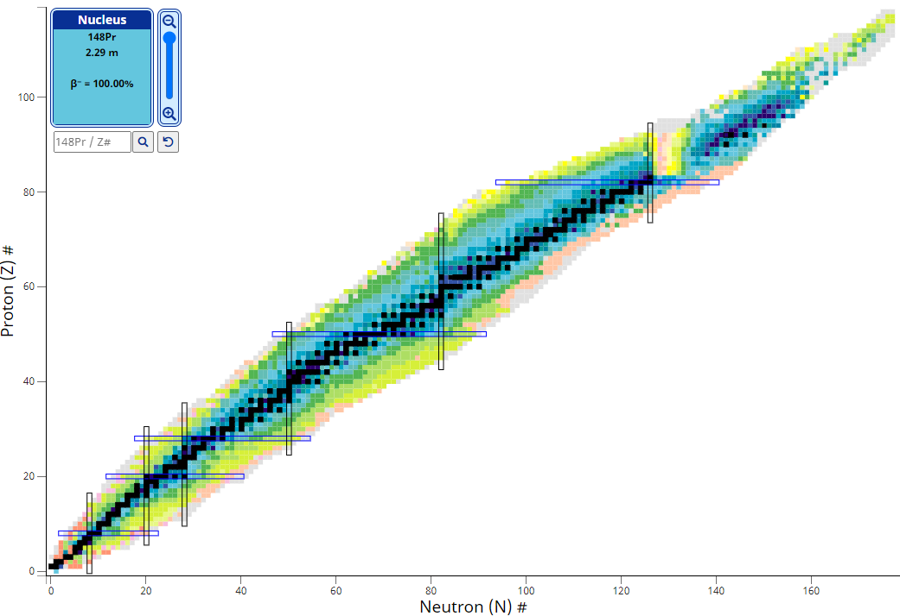
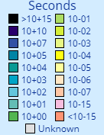
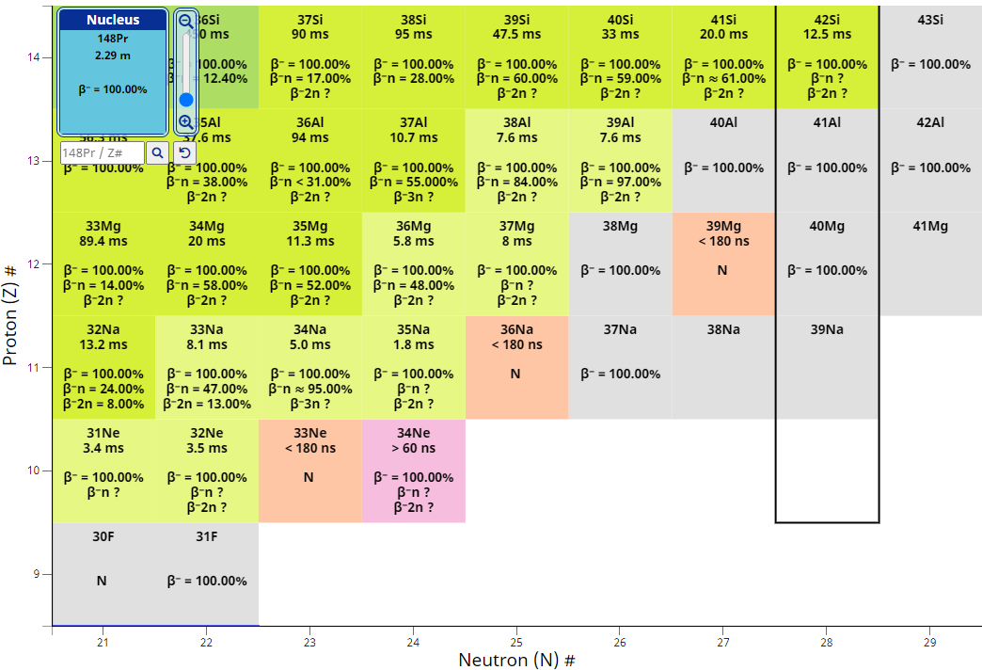
Introduction
For a new isotope search, accurately predicting the production cross section of neutron-rich nuclei near the drip line is very important for discussing their particle stability.
NNDC NuDat 3.0 Nuclear Chart
■ Beta stable nuclides
The most neutron-rich nuclei (Z=9-14)
³¹F
^{31,34}Ne
³⁷Na
^{37,38}Mg
^{40,41}Al
⁴³Si
⁴⁰Mg, ⁴²Al

Slide 4
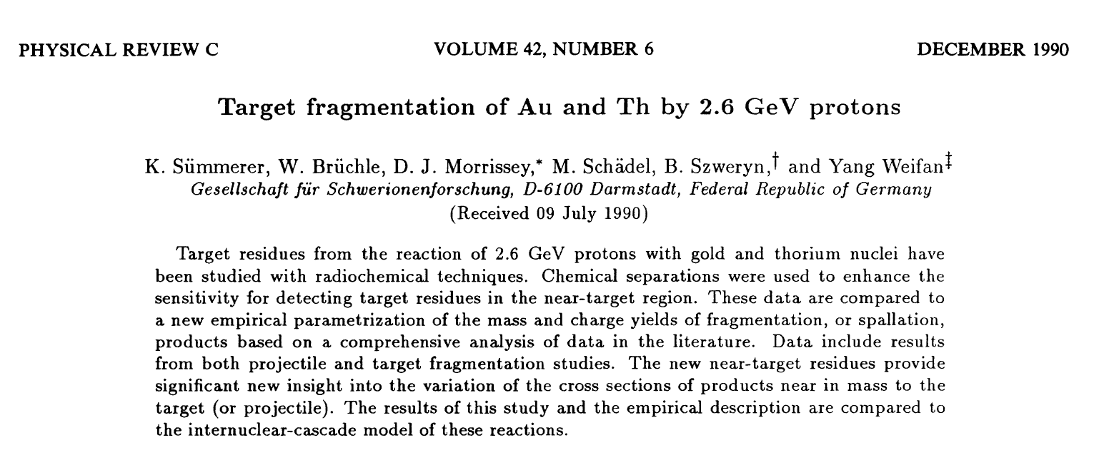
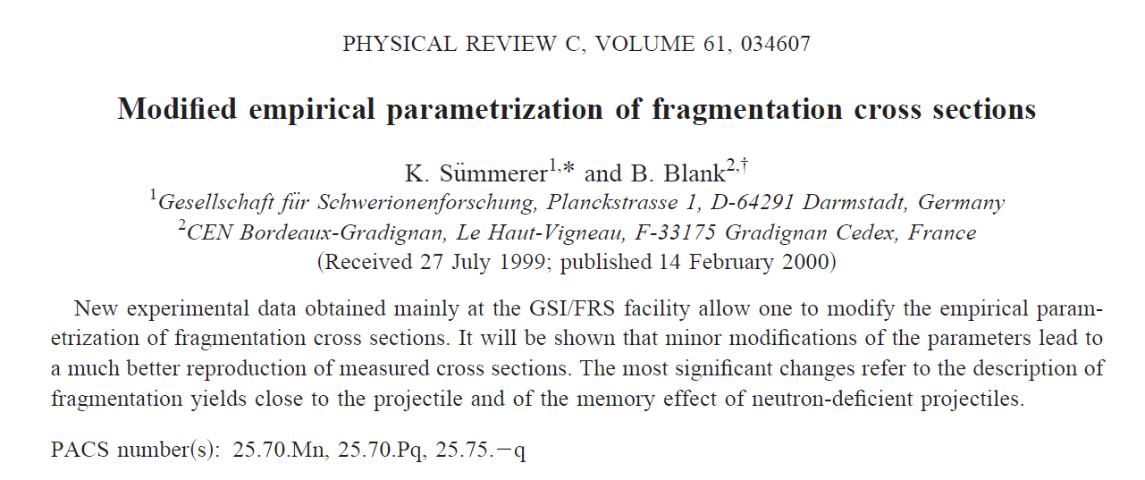
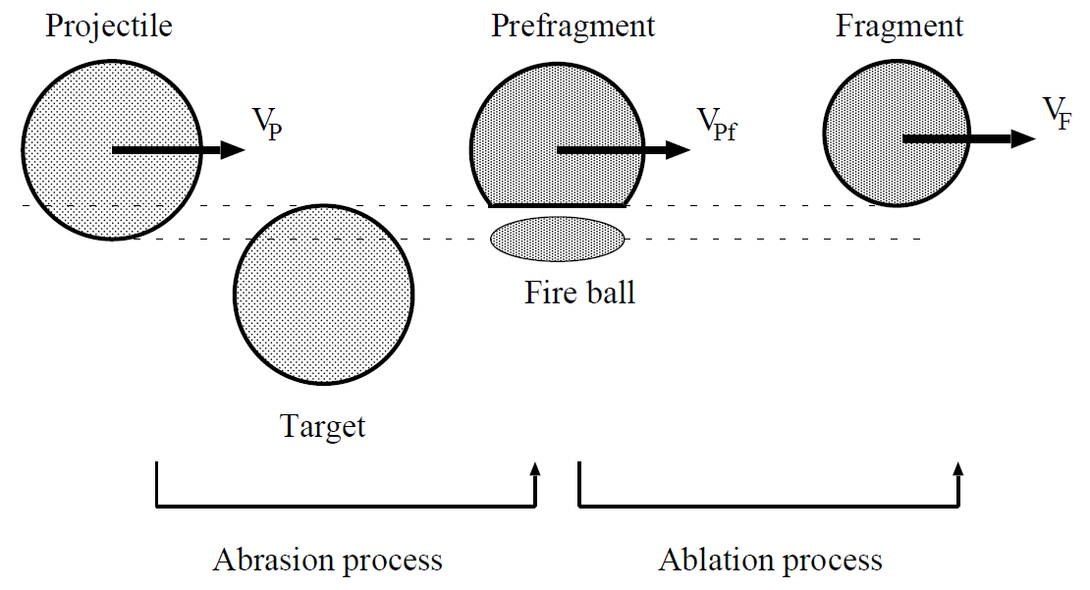
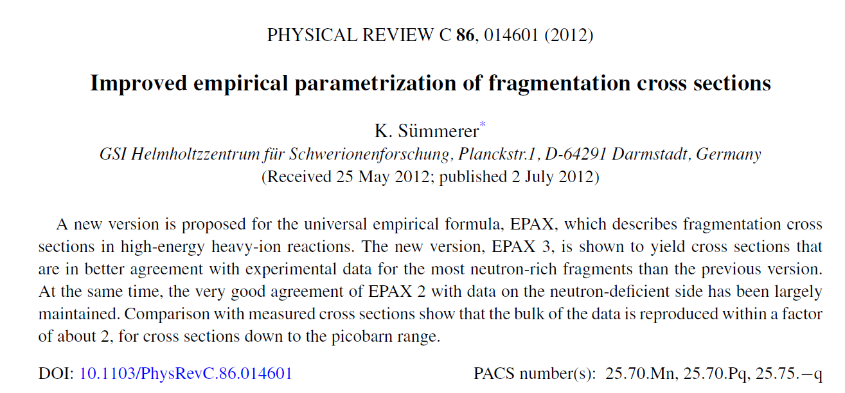
Introduction (Cont.)
Empirical parametrization of fragmentation cross section (EPAX) & Abrasion-Ablation (AA) model is widely used for
(1) designing nuclear experiments with secondary beams
(2) deducing production cross sections
EPAX version 1: mainly for medium- and heavy-mass fragments via multi-GeV high-energy fragmentation reactions
EPAX version 2: memory effect & small modification
EPAX version 3: memory effect & the most neutron-rich fragments
EPAX version 1
EPAX version 2
EPAX version 3

Slide 5
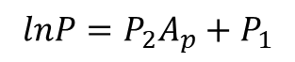
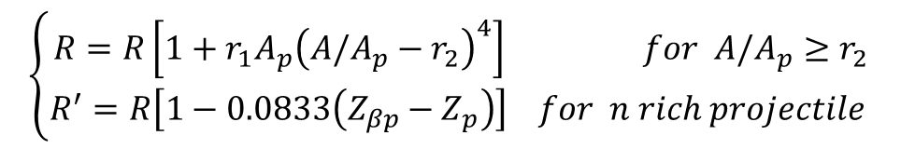
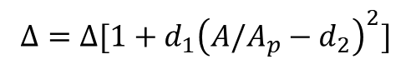
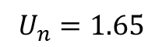
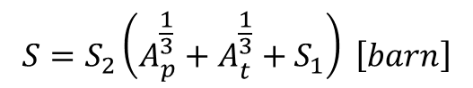
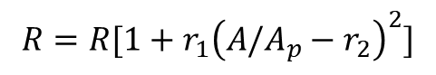
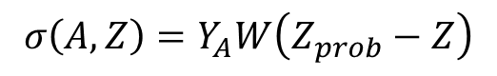
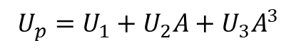
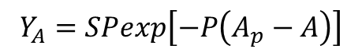
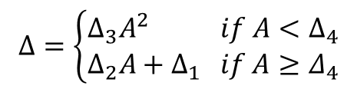
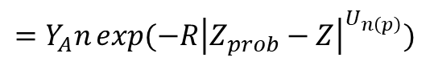
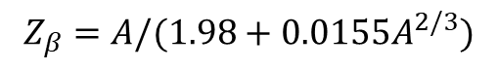
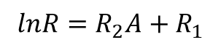
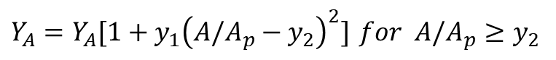
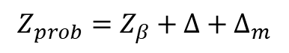
Introduction – EPAX version 2 (Cont.)
$$σ\left(A,Z\right)=Y_{A}W\left(Z_{prob}−Z\right)$$
Max charge dispersion Z_{prob}
Memory effect Δ_{m}
$$=Y_{A}n\exp{(−R{\left|Z_{prob}−Z\right|}^{U_{n\left(p\right)}})}$$
$$Z_{prob}=Z_{β}+Δ+Δ_{m}$$
$$Δ_{m}=[n_{1}{\left(A/A_{t}\right)}^{2}+n_{2}{\left(A/A_{t}\right)}^{4}](Z_{p}−Z_{βp})$$
$$Z_{β}=A/(1.98+0.0155A^{2/3})$$
$$Δ_{m}=[p_{1}{\left(A/A_{t}\right)}^{2}+p_{2}{\left(A/A_{t}\right)}^{4}](Z_{p}−Z_{βp})$$
σ = fragment production XS
Y_{A} = yield of mass number A (= Σσ_{A})
W(Z) = charge distribution
n = normalization factor = (R/π)^{1/2}
R = Width parameter
Z_{prob} = the maximum of charge dispersion
around A
U_{n(p)} = n/p-rich slope
$$Δ=\left\{\begin{aligned}Δ_{3}A^{2} if A<Δ_{4} \\ Δ_{2}A+Δ_{1} if A≥Δ_{4}\end{aligned}\right.$$
$$Δ=Δ[1+d_{1}{\left(A/A_{p}−d_{2}\right)}^{2}]$$
Width parameter R
n/p-rich slope
$$lnR=R_{2}A+R_{1}$$
$$U_{n}=1.65$$
Mass Yield Y_{A}
$$R=R[1+r_{1}{\left(A/A_{p}−r_{2}\right)}^{2}]$$
$$U_{p}=U_{1}+U_{2}A+U_{3}A^{3}$$
$$Y_{A}=SPexp\left[−P\left(A_{p}−A\right)\right]$$
$$\left\{\begin{aligned}R=R\left[1+r_{1}A_{p}{\left(A/A_{p}−r_{2}\right)}^{4}\right] for A/A_{p}≥r_{2} \\ R^{′}=R\left[1−0.0833\left(Z_{βp}−Z_{p}\right)\right] for n rich projectile \end{aligned}\right.$$
$$S=S_{2}\left(A_{p}^{\frac{1}{3}}+A_{t}^{\frac{1}{3}}+S_{1}\right) \left[barn\right]$$
$$lnP=P_{2}A_{p}+P_{1}$$
$Y_{A}=Y_{A}[1+y_{1}{\left(A/A_{p}−y_{2}\right)}^{2}]$ $for A/A_{p}≥y_{2}$

Slide 6
Introduction (Cont.)
The predicting power of EPAX and AA model is not strong enough for specific very neutron rich nuclei
e.g. target dependence is not taken into account in these models
However, strong target dependence of production yields on N/Z ratio was found (X)
Therefore, it is of great interest to determine whether XS measured with different targets factorize in projectile fragmentation at intermediate energies
It is necessary to understand reaction mechanisms fully and to learn the systematic behaviors of XSs for enhancement of predictive power
It requires precise measurement of fragment momentum distribution and production XS

Slide 7
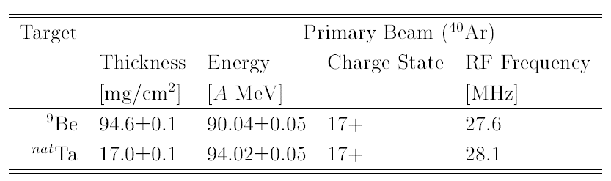
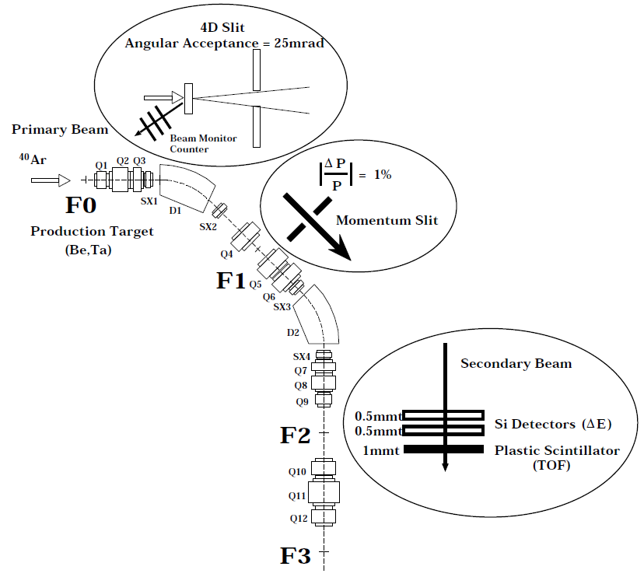
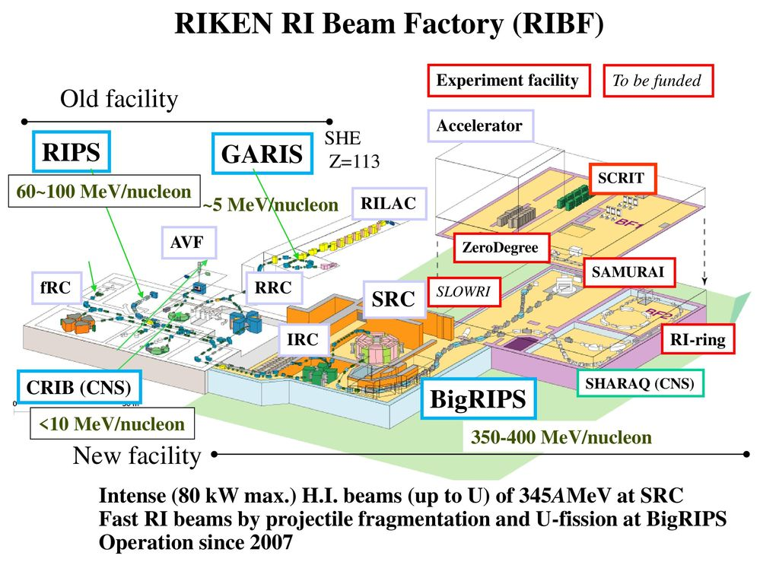
Experimental Setup
⁹Be target
ρ = 1.85 g/cm³
d = 486.49 μm
^{nat}Ta target
ρ = 16.89 g/cm³
d = 10.07 μm
100 MeV/u ⁴⁰Ar + ⁹Be (95 mg/cm²) & ^{nat}Ta (17 mg/cm²) with RIKEN-RIPS
Primary beam monitor
- PS telescope (50 x 50 x 0.5 mm³)
- Backward angle: 135º
- Distance from target: 0.5 m
- Triple coincidence
- Calibrated with Faraday cup
Double achromatic spectrometer
- Angular acceptance (θ, Φ): ±12.5 mrad
- Momentum acceptance: dp/p =1% at F1 with rectangular slit
- Projectile emitted at 0º focus to double achromatic focal plane (F2)
- All fragments in flight are fully stripped (Q = Z)
- D1 & D2 magnetic rigidity (Bρ): 2.520 – 4.068 Tm
90A & 94A MeV ⁴⁰Ar¹⁷⁺
(accelerated by ring cyclotron RRC)
RI Identification
- Z from Si Detectors (SSD1, SSD2)
- Length (Target-F2 PS): 21.3 m
- ToF
1) start: RF signal from cyclotron
* time jitter ~ 0.09 ns
2) stop: F2 PS signal
* ToF time resolution = 0.27 ns (r.m.s.)
F2 Secondary Beam Image by PPAC
- to confirm transmission
- Beam X position correction to center
by tunning D2 field
(D1 & D2 field difference < 0.05%)

Slide 8
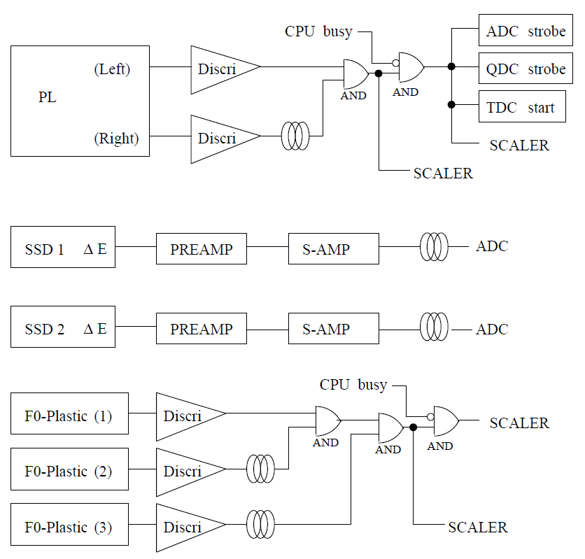
Experimental Setup (Cont.)
One PL & 2 PMT (Left, Right)
Discriminator: LLD & CFD for timing
2 AND: coincidence
SCALER: prevention for signal pileup (Sampling rate < 0.1MHz)
Preamp: Charge-sensitive for conversion of collected charge (current) to voltage (pulse)
Discriminator: LLD & CFD for timing
3 AND: triple coincidence
SCALER: prevention for signal pileup due to high primary beam intensity

Slide 9
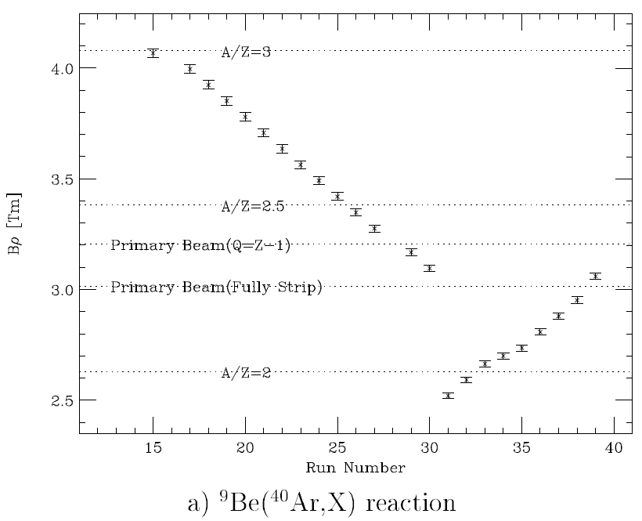
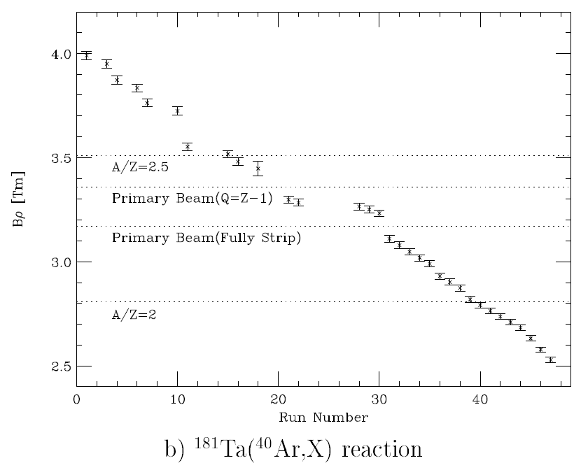
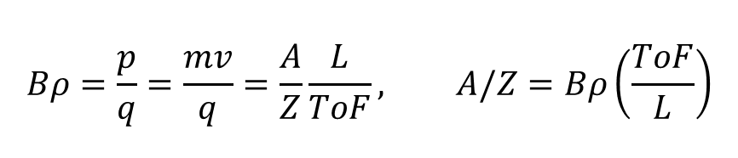
Experimental Setup (Cont.)
- D1 & D2 magnetic rigidity (Bρ): 2.520 – 4.068 Tm (⁹Be, 23 settings; Ta 32 settings)
$$Bρ=\frac{p}{q}=\frac{mv}{q}=\frac{A}{Z}\frac{L}{ToF}, A/Z=Bρ\left(\frac{ToF}{L}\right)$$
앞에 데이터 아마 버린 듯 합니다.

Slide 10
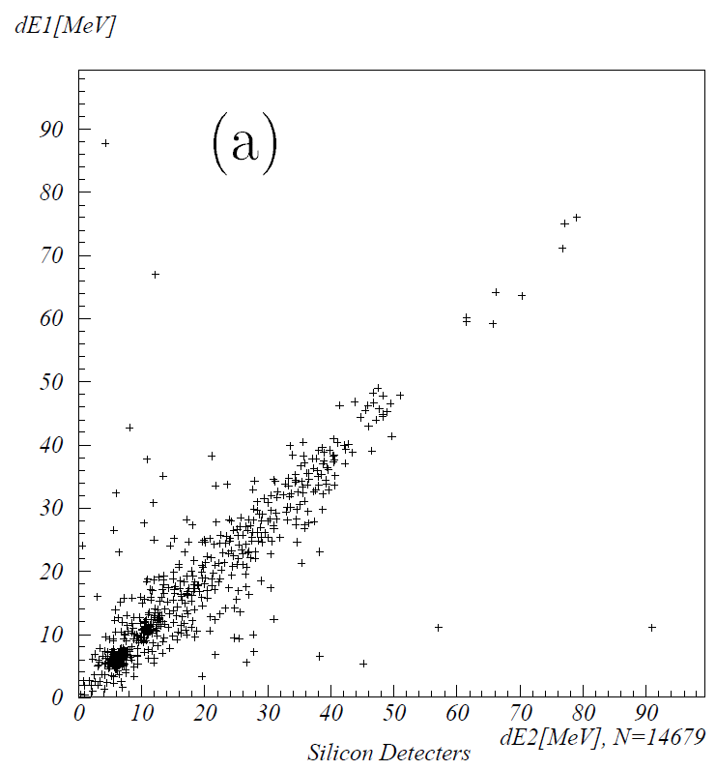
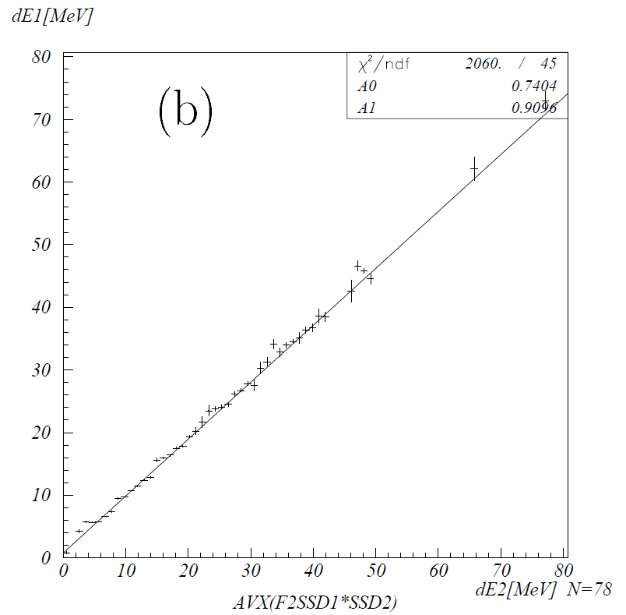
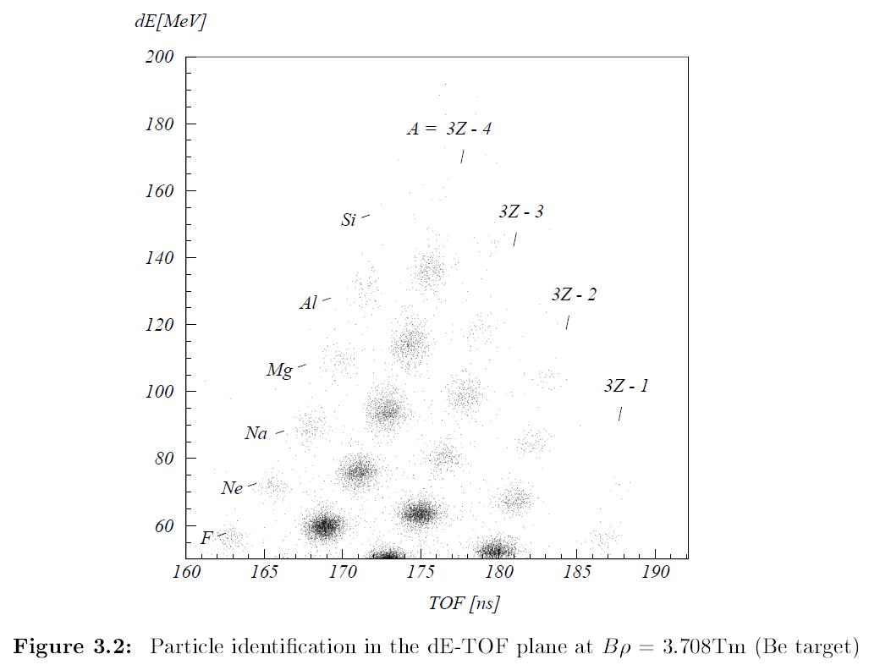
RI Identification
Particle Identification (PID)
- 2D plot of ToF vs. ΔE in SSD1
- Background rejection with correlation gate (σ) between SSD1 & SDD2
(Background)
1) Scattered primary beam
2) Nuclear reaction of fragments in Si detector
3) Reaction at the edge of Si detector …
- so, fragment PID with low background events
- (Fragment yields) = (count of isotope from PID)
Identified Fragment ²⁸Si¹⁴⁺
- Energy = 85.45 MeV/u (velocity = 12.04 cm/ns)
- Energy loss in SSD 0.5 mm thick = 152 MeV
- ToF = L/velocity = 176 ns

Slide 11
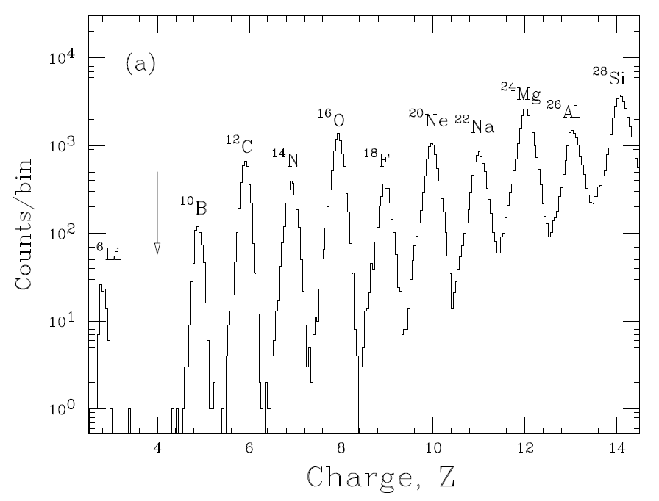
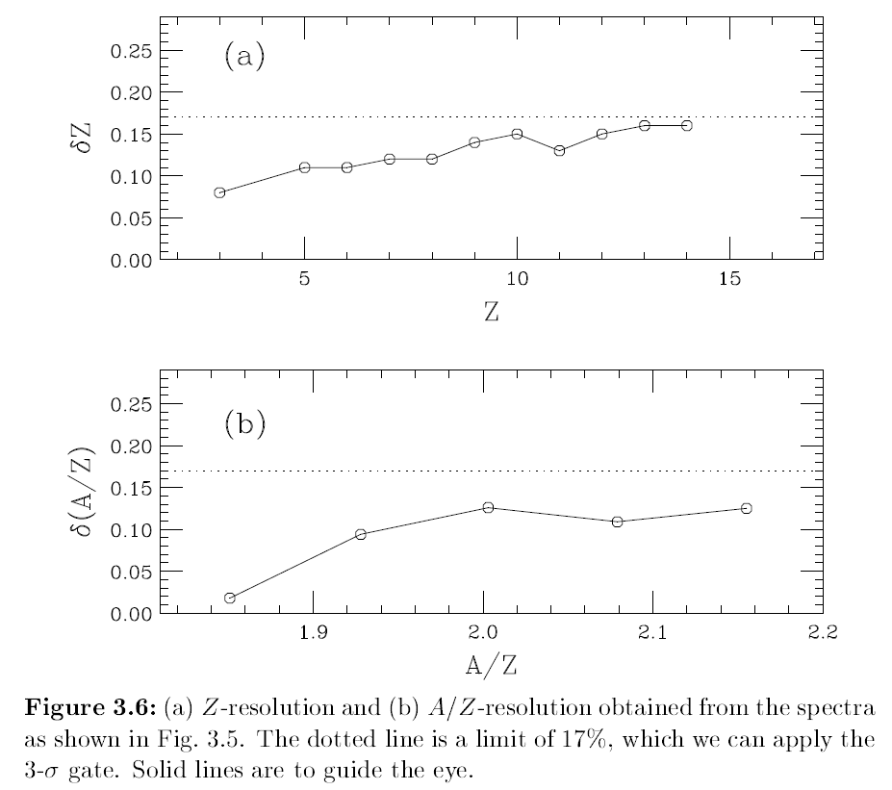
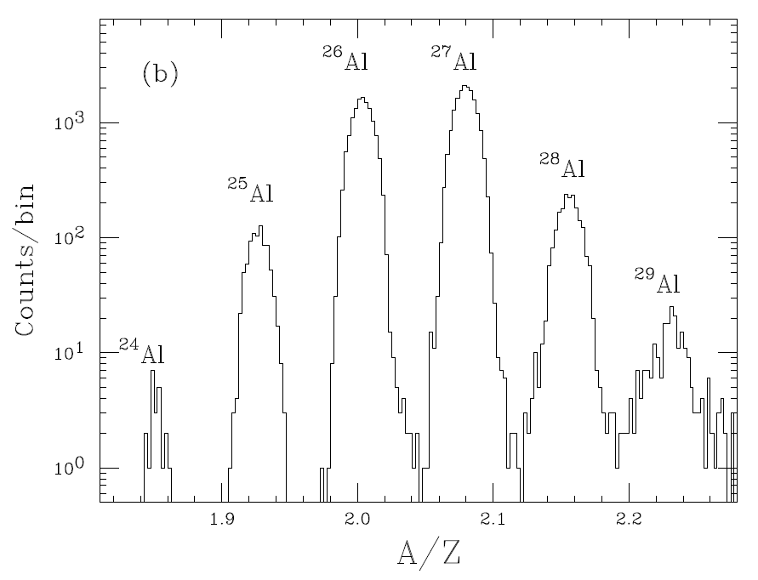
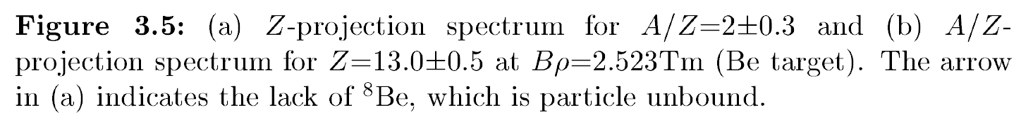
RI Identification (Cont.)

Slide 12
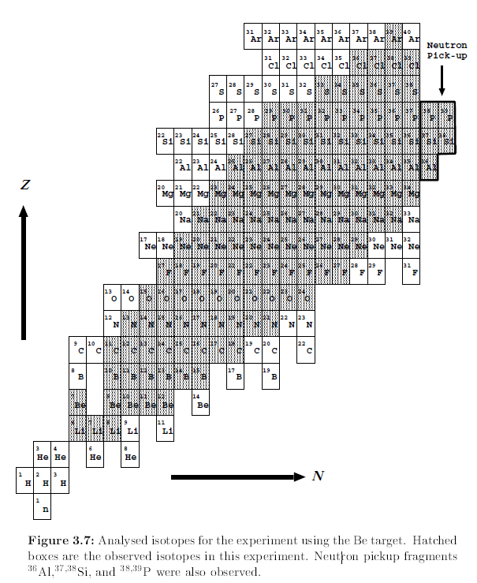
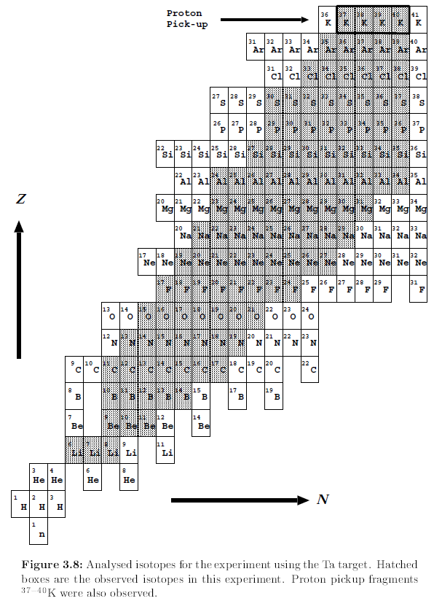
RI Identification (Cont.)
Neutron pick-up: Projectile ⁴⁰Ar + n or +2n (transfer-like fragment)
Proton pick-up: Projectile ⁴⁰Ar + p or +2p (transfer-like fragment)

Slide 13
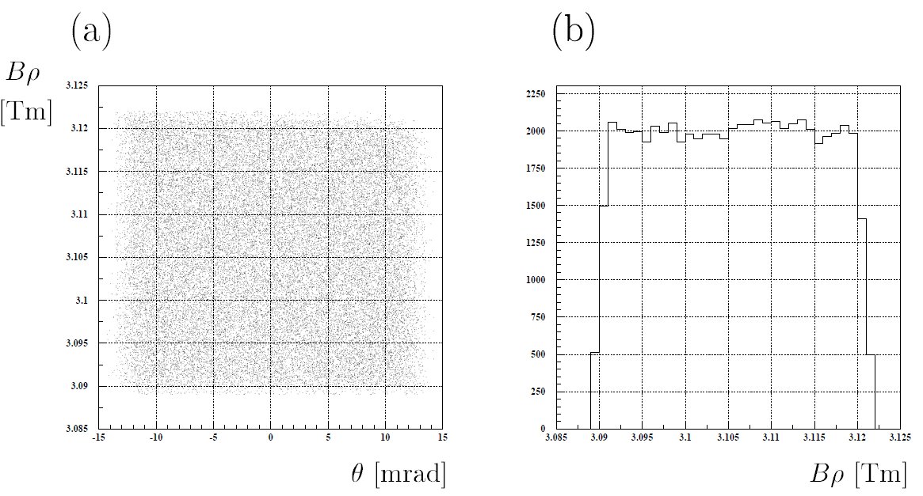
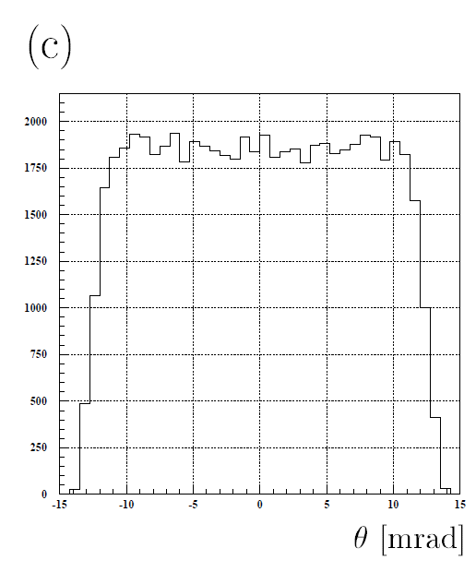
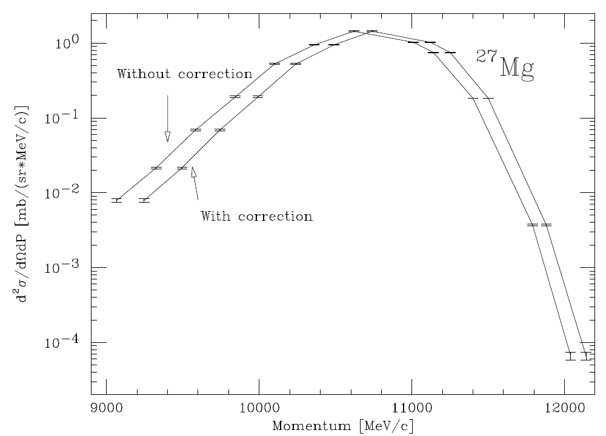
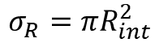
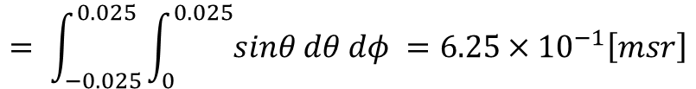
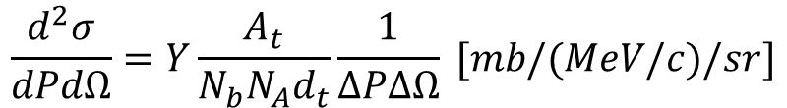
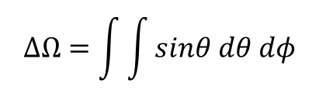
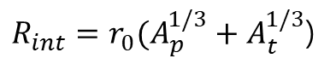
Differential Cross Section (dσ²/dPdΩ)
※ Correction List
1. Transmission loss
- using 3th optics calculation (MOCADI code)
- 95.3±0.3% (Reference particle ⁴⁰Ar)
- Fragment Yield Y need to be corrected
- F1 slit correction is not applied in this paper (negligible)
2. Energy loss at target
- Assume the fragmentation reactions occur at the half depth of the target
- to minimize isotope dependence of momentum distribution
- Energy loss
1) (Be target) 2.5 AMeV
2) (Ta target) 0.27 AMeV
3. Reaction loss at detector
- Reaction loss fraction
= 0.8% for ⁴⁰Ar projectile (negligible)
$$\frac{d^{2}σ}{dPdΩ}=Y\frac{A_{t}}{N_{b}N_{A}d_{t}}\frac{1}{ΔPΔΩ} [mb/(MeV/c)/sr]$$
Y = Fragment yield
N_{b} = Primary beam intensity
N_{A} = Avogadro number 6.022×10²³ atoms/mol
A_{t} = Atomic number of target (Be 9.012 g/mol, Ta 180.95 g/mol)
d_{t} = Target thickness (Be 0.0946 g/cm², Ta 0.016g/cm²)
ΔP = Momentum acceptance 1%
ΔΩ = Angular acceptance 6.25×10⁻¹ msr
$$ΔΩ=\int{\int{sinθ dθ dφ}}$$
$$= \int_{−0.025}^{0.025}{\int_{0}^{0.025}{sinθ dθ dφ}} =6.25×{10}^{−1}\left[msr\right]$$
$$σ_{R}=πR_{int}^{2}$$
σ_{R} = total XS
r₀ = constant value 1.1 fm
A_{p,t} = mass number of projectile and silicon
$R_{int}=r_{0}(A_{p}^{1/3}+A_{t}^{1/3}$)
Decrease asymmetry

Slide 14
Contents of Results & Discussion
Asymmetric Momentum Distributon
Momentum Peak Shift
Parabolic mass dependence
Acceleration Phenomenon in light fragments
High & Low Momentum Side Width (σ_{L}, σ_{H})
Transfer-like Fragmentation
Target Dependence of Production Cross Section
EPAX Modification

Slide 15
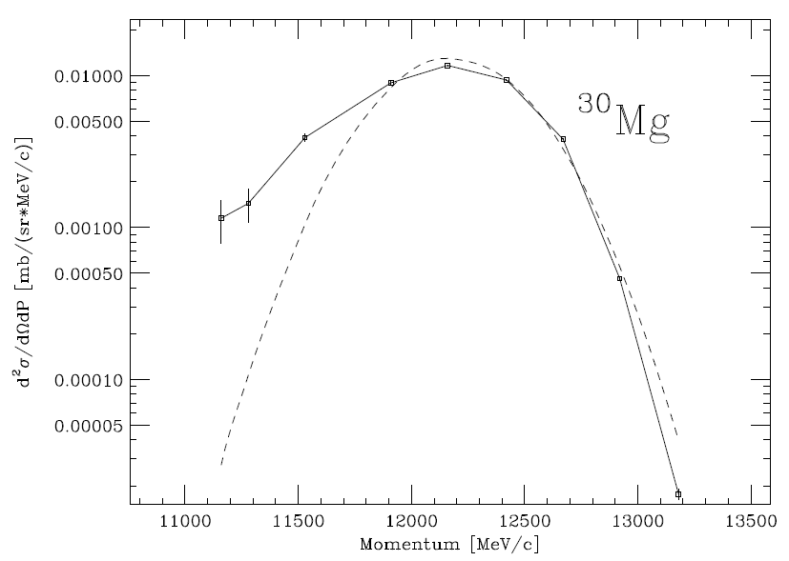
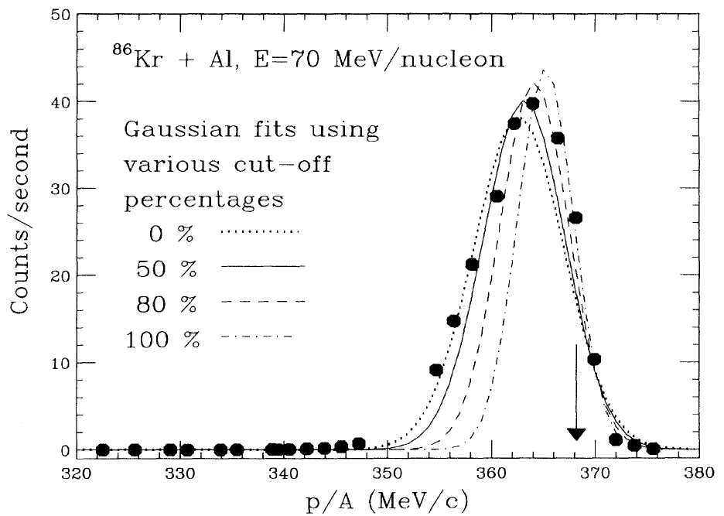
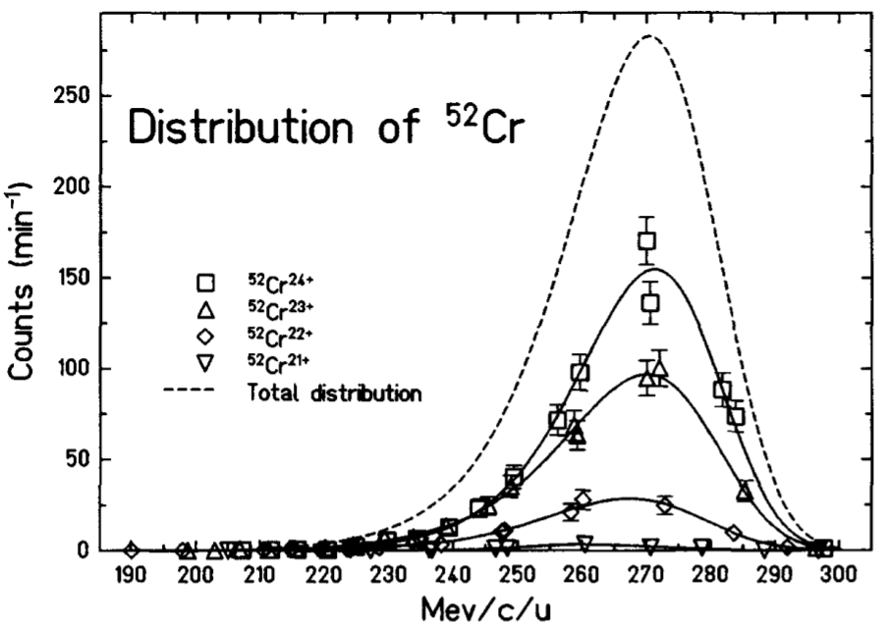


Results & Discussion – Momentum Distribution
have information for understanding reaction mechanism
(Relativistic E)
- Symmetric; fitted to Gaussian form
- width σ with respect to Fermi motion of nucleons or temperatures of fragments
(Intermediate E)
- Asymmetric; tail on the low-momentum side
- Fitted with several kinds of trial functions for P₀ and width σ
- Since physical models have not been established for the low-momentum tail,
it is unclear what kind of functions are appropriate to use
(1) R. Praff et al. (PhysRevC.51.1348 1995)
- single Gaussian function on FWHM range
(2) D. Banzin et al. (NuclPhysA.515.349 1990)
- analytic function F(p) of a polymonial exponential function
- physical meaning is not clear
(3) Ch.O. Bacri et al. (NuclPhysA.555.477 1993)
- Gaussian function for high momentum side + Exponential tail function for low momentum side
- Useful for understanding the behavior for low mentum side
- But, different width is necessary to link between two functions
$$F\left(p\right)=exp\sum_{i=1}^{5}{a_{i}{\left(p/K\right)}^{i}}$$

Slide 16



Results & Discussion – Momentum Distribution
P₀
P₀
σ
σ_{L}
σ_{H}
$$\frac{d2σ}{dPdΩ}\left(θ=0o\right)=\left\{\begin{aligned}A\exp\left[−\frac{\left(P−P0\right)2}{2σL2}\right] for P≤P0, \\ A\exp\left[−\frac{\left(P−P0\right)2}{2σH2}\right] for P≥P0,\end{aligned}\right.$$
$$\frac{d2σ}{dPdΩ}\left(θ=0o\right)=A\exp\left[−\frac{\left(P−P0\right)2}{2σ2}\right] for P≥P0 \left[\frac{mb}{sr∙MeV}\right]$$
[ Type I: Gaussian Function ]
[ Type II: Asymmetric Gaussian-like Function ]
P₀: the most probable momentum peak value
σ_{L}, σ_{H}: the momentum width in the low- and high-energy sides
- Maximum likelihood method fitting to treat small statistics at the tails
Maximum likelihood method

Slide 17




Results & Discussion – Momentum Distribution
Moreover, another kind of complexity
(Fragment ³⁰Mg)
- Single component near the projectile velocity (β_{proj})
- No significant LE component
(Fragment ¹⁰Be)
- Two components (HE, LE) in light fragments only for Be target
∙ HE component: asymmetric Gaussian
∙ LE component: symmetric Gaussian (only for A = 9-12)
∙ LE component is related to reaction mechanism with a small impact parameter
1) LE component decreases with increasing fragment mass number (mass dependence)
2) In Ar+Be reaction, Ar projectile collisions Be target with small impact parameter
3) Due to deep impact, the reaction makes a compound nuclear system running at a velocity
near the center-of-mass system of Ar+Be (β_{cm})
4) Compound nucleus is heated up to very hot nuclear system due to energy conversion
from a kinetic energy of projectile to an internal energy of compound system
Dash line: LE, HE component
Dot line: symmetric Gaussian
β_{proj}: high-energy side of the peak
β_{c.m.}: low-energy side of the peak
Impact Parameter (b)
$$b=\frac{Z_{1}Z_{2}ke^{2}}{mv_{0}^{2}}\cot{\frac{θ}{2}}=\frac{Z_{1}Z_{2}ke^{2}}{2 KE}\sqrt{\frac{1+cosθ}{1−cosθ}}$$

Slide 18




Results & Discussion – Production Cross Section
Production XS of fragments were evaluated with fitting results of the longitudinal momentum distributions
Transverse momentum distribution are assumed to be a Gaussian function with a width of σ$⊥$
$$σ_{⊥}^{2}=σ_{H}^{2}+\frac{A_{f}(A_{f}−1)}{A_{p}(A_{p}−1)}σ_{D}^{2}$$
σ_{H}: high-energy momentum width
σ_{D}: deflection effect parameter
A_{p}: mass number of the projectile
A_{f}: mass number of the fragment
Van Bibber et al. (PhysRevLett.43.840 (1979)
σ_{D} = 190-220 MeV/c without target dependence (from ²⁷Al + 92.5 MeV ¹⁶O & ¹⁹⁷Au + 117.5A MeV ¹⁶O)
In this work, σ_{D} = 195 MeV/c around 90A MeV (energy dependence reported in NuclPhysA.460.299.1986)
Doubly-differential XS
$$\frac{d^{2}σ}{dPdΩ}=\exp\left(−\frac{P_{⊥}^{2}}{2σ_{⊥}^{2}}\right)×\left\{\begin{aligned}A\exp\left(−\frac{{\left(P_{||}−P_{0}\right)}^{2}}{2σ_{L}^{2}}\right) for (P_{||}≤P_{0}) \\ A\exp\left(−\frac{{\left(P_{||}−P_{0}\right)}^{2}}{2σ_{H}^{2}}\right)for (P_{||}≥P_{0})\end{aligned}\right.$$
$$σ=\int_{0.025}^{0.025}{dφ\int_{0}^{0.025}{sinθ dθ\int_{0}^{∞}{\frac{d^{2}σ}{dPdΩ}dP}}}$$

Slide 19




Results & Discussion – Systematic Error
The ambiguity of transverse momentum distributions was taken into account as the systematic error of XS (???)
Overall systematic error for the production XS (solid line)
Dashed line shows originated from ambiguity σ$⊥$

Slide 20


Results & Discussion – Momentum Peak Shift
20
87.5 AMeV
= (projectile velocity) – (the most probable velocity of fragment from P₀)
Unit: MeV per nucleon [A MeV]
Energy loss
in fragmentation process
Systematic error ~ 0.9%
- element chain deviation vary widely in Be target, which is dominant to systematic error
- can be deviation as an effect of target thickness in the atomic energy-loss process
Parabolic mass dependence on both targets (Be, Ta)
- maximum momentum peak shift around Af = 20
Fragment acceleration in Be target
- ^{6,7}Li, ⁹⁻¹¹Be, ¹⁰⁻¹³B are larger than the projectile velocity
- accelerated in reaction process
- also observed in collisions of Pb + 1A MeV ²³⁸U [X]
- no acceleration for any fragments Af ≥ 8 in Ta target
- no significant difference between targets in momentum peak shift with Af > 20
½ A_{p}
93.8 AMeV
Fragment 핵자당 에너지는
Projectile 질량차가 적을수록 Projectile 핵자당 에너지에 근접함.
(the most probable momentum peak 기준)
½ A_{p}
ΔA = A_{p} - A_{f}

Slide 21



21
Results & Discussion – Parabolic Mass Dependence of Momentum Peak Shift
Many of the reports have shown a linear mass dependence of the peak shift for fragments A_{f} ≥ A_{p}/2
1) Greiner et al (1975)
- In 2.1A GeV ¹²C fragmentation, the empirical formula:
- small energy transfer to the fragment exclude the possibility of nuclear reactions involving charge exchange
2) Cumming et al
- to describe the dependence of average forward momentum transfer <P||> on the mass loss
3) Borrel et al
- Velocity shift at intermediate energy:
- it begins to overestimate the velocity shift below A_{f} ~ A_{p}/2
4) J.A. Winger et al (dash line)
- to compensate for this deviation in below A_{f} ~ A_{p}/2, mathematically symmetric formula with A_{p}/2
→ However, all of this investigations cannot predict the parabolic mass dependence
$$<P_{||}> =0.5σ_{P||}+30.0 [MeV/c]$$
p₀ = average longitudinal momentum transfer per unit mass loss
β = projectile velocity
k = <p||> decrease rate with β increase, which differs among the different models
- E0=13 MeV per unit mass loss and k=0 (Kaufman et al 0.4-2.1 GeV ²⁰Ne + ¹⁹⁷Au)
- E0=8 MeV per unit mass loss and k=1 (Morrissey et al 0.4 A MeV ¹²C + Cu)
$$p_{0}=\frac{E_{0}}{β}[1+k{\left(1−β^{2}\right)}^{1/2}]$$
$$\frac{v_{f}}{v_{p}}=\sqrt{1−\frac{8(A_{p}−A_{f})}{A_{f}E_{p}}}$$
E_{p} = projectile energy in A MeV
The average energy used to pull out a single nucleon from
projectile nucleus is to be 8 MeV

Slide 22



22
Results & Discussion – Parabolic Mass Dependence of Momentum Peak Shift (Cont.)
Borrel comment [X]
“symmetric behavior of the velocity shift implies another mechanism less costly, compared with the removal of individual nucleons. The mechanism may be splitting or instant crack of projectile into two pieces.”
Weizsacker-Bethe empirical mass formula:
(Assume it is not excited state)
The energy(mass) loss in the splitting process:
- Binding energy is dominant and shows the parabolic mass dependence of peak shift
However, the energy loss in splitting process gives only several tens percent of the value measured as momentum peak shift, quantitatively
Empirical formula
1) Splitting process consumes the kinetic energy of projectile due to the excitation
2) Energy cost to form a fragment is proportional to the number of pairs of nucleons interacting in long range forces
which are broken in the reaction
Assumption: 1) Nucleon in projectile are bound each other, so the pairing number of nucleons is
2) The projectile splits into the spectator (A_{f}) and the participant (A_{p}-A_{f})
3) Then, the decrease of pairing number is
4) The kinetic-energy loss for one nucleon removal from projectile: ε
$$M\left(N,Z\right)=NM_{n}+ZM_{p}−B\left(N,Z\right)$$
$$B\left(N,Z\right)=b_{vol}A−b_{suf}A^{2/3}−\frac{1}{2}b_{sym}\frac{{\left(N−Z\right)}^{2}}{A}−\frac{3}{5}\frac{Z^{2}e^{2}}{R_{c}}$$
$$M\left(N_{f},Z_{f}\right)+M\left(N_{p}−N_{f},Z_{p}−Z_{f}\right)−M(N_{p},Z_{p})$$
$$ApC_{2}=A_{p}(A_{p}−1)/2$$
$$ApC_{2}−AfC_{2}−Ap−AfC_{2}=A_{f}(A_{p}−A_{f})$$

Slide 23


23
Results & Discussion – Parabolic Mass Dependence of Momentum Peak Shift (Cont.)
When one nucleon is removal (A_{f}=A_{p}-1), the decrease of pairing number in the splitting process is A_{p}-1
The energy loss of one nucleon removal can be defined as ε
Thus, the energy loss per nucleon pair is ε/(A_{p}-1) [MeV]
The number of pairing broken in the splitting process is A_{f}(A_{p}-A_{f})
Therefore, the kinetic energy loss is
In the case of non-relativistic projectile energy, the energy conservation between projectile and two pieces gives
a new formula as follows:
If we select the energy loss parameter of ε = 8 MeV, it corresponds to Borrel’s formula for the one-nucleon removal
However, fitting results is better in ε = 12 MeV than ε = 8 MeV
This energy loss parameter 8 MeV is equally applied to the experimental data in Ar+Be & Ar+Ta
$$ΔE=\frac{εA_{f}(A_{p}−A_{f})}{A_{p}−1}$$
$$\frac{v_{f}}{v_{p}}=\sqrt{1−\frac{ΔE}{A_{p}E_{p}}}−1=\sqrt{1−\frac{εA_{f}(A_{p}−A_{f})}{A_{p}E_{p}(A_{p}−1)}}$$

Slide 24

24
Results & Discussion – Acceleration Phenomenon
- Cannot explained by a fragmentation model based on the AA model picture, in which the projectile loses the kinetic
energy in the laboratory system for the abrasion process of nucleus
- No acceleration effect in Ta target
- Acceleration phenomenon & LE component in Be target
(LE component)
- Would be related to multi-fragmentation
- from c.m velocity of the incident system
- so, originate from highly excited compound system generated via central collision
(Acceleration Phenomena)
- by microscopic model calculation [X]
- post-acceleration of light fragments due to the response of the projectile
spectator to the participant blast
- the spectator pass by the participant region when the participant matter
undergoes a violent blast
- The explosion pushes the spectators, giving them transverse momentum,
which is pointed away from the reaction zone [Benlliure et al. X]
A_{f}≤13

Slide 25

Results & Discussion – Acceleration Phenomenon (Cont.)
F. Auger et al suggested
“the light fragments in ⁸⁴Kr+C and ⁸⁶Kr+Al collisions originates from
the splitting of a composite system.”
Two components of velocity (β_{CM}, β_{proj}) are cleary seen
At this experiments, the projectile energy was relatively low, 35A MeV
So, authors suggested
“fission-like fragments may be produced from a highly excited compound
system”
(2D plot) Velocity vs. Atomic number
in ⁸⁴Kr + ¹²C and ⁸⁴Kr + ²⁷Al reaction

Slide 26





Results & Discussion – High Momentum Side Width (σ_{H})
compared with Goldhaber formulation
- solid curve with the reduced width σ0 = 90 MeV/c (relativistic E experiment [X])
- dashed line with mean value of
(Be target) σ₀ = 93.5±2.6_{stat}±7.5_{sys}
(Ta target) σ₀ = 97.4±1.8_{stat}±7.8_{sys}
- no significant difference between the targets
(Light Fragment, A_{f} < 13)
- slight deviation from Goldhaber model
- originates from LED component and fitting function
- The overall results are in good agreement with high-energy experiments
(Reduced width σ₀)
- independent of the primary beam energy
- but, at lower energies, the reduction of σ0 has been observed [X]
- theoretically “Pauli blocking”
- energy dependence at 30-40A MeV [X]
- , and constant up to 90A MeV
- the measured σ0 is the same as high-energy one
$$σ\text{||} \text{=} σ\text{0} \text{+}\sqrt{\frac{\text{A}\text{f}\text{ (}\text{A}p\text{−}\text{A}\text{f}\text{ )}}{\text{A}\text{p}\text{ (}\text{Ap}\text{−1)}}}$$

Slide 27


Results & Discussion – Low Momentum Side Width (σ_{L})
compared with high momentum side width σ_{H} (Goldhaber model)
- large width cannot be explained by the Goldhaber model
- different from parabolic feature of σ_{H}
- may have linear dependence as a function of mass loss ΔA
- no significant target dependence between both targets
Mountain-like style structure for each isotope chain in Be target
- no such data in Ta target
- due to target thickness effect
- or due to LE component at the low-momentum side
- In the fitting procedure with an asymmetric Gaussian-like function,
LE component may also affect the results of σ_{L}
- Therefore, mountain-style structure should be ignored and
treated as a systematic error (systematic error of σ_{L} ~ 8%)
σ_{L}(ΔA→0) = 300-400A MeV
- differ from Goldhaber model (σ_{L}(ΔA→0) = 0)
- additional reaction process is necessary for intermediate-energy reaction
even if fragmentation reaction is dominant

Slide 28

Results & Discussion – Transfer-like Fragmentation
Transfer-like fragments: ³⁶Al, ^{37,38}Si, ^{38,39}P, and ³⁷⁻⁴⁰K
More neutrons or protons than projectile nucleus ⁴⁰Ar (N > 22 or Z > 18)
Cannot be produced with projectile fragmentation reactions
Neutron or proton pick-up process are necessary
Fit with an asymmetric Gaussian function
Due to the lack of data at low-momentum tail,
The assumptions are as follows:
1) σ_{H} was taken from Goldhaber formula with σ₀=90 MeV/c
2) σ_{L} was assumed to be 400±60_{sys} MeV/c
The momentum peak shift (4.6 A MeV) is clearly larger than that of the same mass number (~0.9 A MeV)
³⁷⁻⁴⁰K (requiring a proton pick-up process) also shows the larger momentum peak shift

Slide 29



Results & Discussion – Target dependence of cross sections
Target dependence of projectile fragmentation XS except for target-size effect
The ratio 1 means the existing factorization is valid (no target dependence)
(the factorization was valid for the isotopes Z_{β} - Z_{f} ≤ 2)
But, the ratios increase when Z_{β} - Z_{f} is increased (very neutron rich nuclei)
Y_{A} (mass yields) = sum of fragment XSs
Z_{β} = the most stable charge of mass number A_{f}
Be target
for 3≤Z≤14
Ta target
for 3≤Z≤19
Ratio of the production cross sections for each fragment
produced with Be and Ta targets.
Measured cross sections

Slide 30








Results & Discussion – EPAX
$$σ\left(A,Z\right)=Y_{A}W\left(Z_{prob}−Z\right)=Y_{A}n\exp{(−R{\left|Z_{prob}−Z\right|}^{U_{n\left(p\right)}})}$$
$$Z_{prob}=Z_{β}+Δ+Δ_{m}$$
$$Δ_{m}=[n_{1}{\left(A/A_{t}\right)}^{2}+n_{2}{\left(A/A_{t}\right)}^{4}](Z_{p}−Z_{βp})$$
$$Δ_{m}=[p_{1}{\left(A/A_{t}\right)}^{2}+p_{2}{\left(A/A_{t}\right)}^{4}](Z_{p}−Z_{βp})$$
$$Δ=Δ[1+d_{1}{\left(A/A_{p}−d_{2}\right)}^{2}$$
$$R=R[1+r_{1}{\left(A/A_{p}−r_{2}\right)}^{2}$$
$$or R=R[1+r_{1}A_{p}{\left(A/A_{p}−r_{2}\right)}^{4}for A/A_{p}≥r_{2}$$
$$U_{p}=U_{1}+U_{2}A+U_{3}A^{3}$$
Deviation < 0.2
$$R^{′}=R[1−0.0833\left(Z_{βp}−Z_{p}\right)]$$
Comparison of the data from Be and Ta targets shows no significant target dependence

Slide 31





$$Z_{prob}=Z_{β}+Δ+Δ_{m}$$
Results & Discussion – EPAX Modification
$$Δ=\left\{\begin{aligned}Δ_{3}A^{2} if A<Δ_{4} \\ Δ_{2}A+Δ_{1} if A≥Δ_{4}\end{aligned}\right.$$
$$Δ=Δ[1+d_{1}{\left(A/A_{p}−d_{2}\right)}^{2}$$
Z_{prob}(EXP) is well described as Z_{prob}(EPAX) as well as Z_{β}
Difference Z_{prob}(EPAX) and Z_{β} is mainly the memory effect Δ_{m}
Since the target dependence of Z_{prob} has not been found, assume that Z_{prob} can be described as the EPAX formula
So, fitting parameters were U (on neutron-rich side) and mass yield Y
This data shows breakdown of factorization (BOF) is related to the target dependence of U for very neutron rich nuclei
$$Δ_{m}=[n_{1}{\left(A/A_{t}\right)}^{2}+n_{2}{\left(A/A_{t}\right)}^{4}](Z_{p}−Z_{βp})$$
Mass dependence U_{n} (Be target)
EPAX2 parameter U_{n} = 1.65
U_{avg} (Ta target) = 1.62
(Smaller U, Larger Y)

Slide 32

Results & Discussion – EPAX Modification (Cont.)
Predictive power of new parametrization
Charge distribution A=24 isobars produced in ⁴⁰Ar+⁹Be and ⁴⁰Ar + ¹⁸¹Ta reactions

Slide 33
Results & Discussion – Origin of Breakdown of Factorization (BOF)
Charge distribution of fragment XS with Be/Ta targets reveals the BOF for very neutron rich nuclei
Authors suggest 2 possible mechanisms that are responsible for the deviation in the charge distribution
1. Nucleon-exchange process
- Transfer-like fragments ³⁶Al, ^{37,38}Si, ^{38,39}P, ³⁷⁻⁴⁰K (neutron or proton rich number larger than ⁴⁰Ar projectile)
- N(Ta) > N(Be): high neutron transfer probability
- Nucleon-exchange reaction between projectile and target during the abrasion process may break factorization
- The probability of nucleon exchange becomes large at low energies
- Nuclear fragmentation experiments with lower incident beam energies than ours may reveal a large BOF effect for very neutron-rich nuclei
2. Isospin dependence of nucleon-nucleon scattering
- σ_{pp} and σ_{pn} scattering XS may lead to the deviation of pre-fragment charge distribution
- σ_{np} is larger than σ_{nn} and σ_{pp} when the nucleon energy is less than 500 MeV
- Neutron-rich target nucleus easily knocks out protons in the projectile nucleus, so that the product of neutron-rich pre-fragments is promoted
- Nuclear fragmentation experiments with 100-800A MeV beams should be carried out to confirm the BOF effect for very neutron-rich nuclei, especially 500A MeV
- XS curves of σ_{pn} and σ_{pp} intersect at 500 MeV, the difference in the U parameter between Be and Ta targets might change sign

Slide 34
Summary & Conclusions
In the efficient design of experiments, the production XS is performed by use of EPAX empirical formula and AA model
EPAX and AA model is not strong enough for specific very neutron rich nuclei (target dependence is not considered)
The aim of this paper is the investigation of
1. reaction mechanism for projectile fragmentation at intermediate energies.
2. target dependence of momentum distribution of projectile fragments
Projectile fragmentation experiments were performed 90-94A MeV ⁴⁰Ar beam with ⁹Be and ^{nat}Ta targets at RIKEN-RIPS
Main experimental results are as follows
1. parabolic mass dependence; maximum momentum peak shift around A_{f} = 20 (1/2 A_{p})
2. acceleration phenomenon in light fragments (3≤A≤X) only for Be target
3. high momentum side width σ_{H} corresponds to the Goldhaber model
4. low momentum side width σ_{H} may have linear dependence (cannot explained with the Goldhaber model)
5. transfer-like fragments were observed, and have larger peak shift than the fragmets with same mass number
6. the ratio of XSs in Ar+Ta to Ar+Be reactions with Z_{β}-Z_{f} shows breakdown of factorization
7. U parameter depends on target mass number, and was applied for new parametrization (modified U parameter)
To understand the physics underlying the BOF, nuclear experiments for projectile fragmentation with lower energy or 100-800A MeV should be performed

Slide 35
Paper List for ⁴⁰Ar Nuclear Experiments at Intermediate energy (10A ~ 50A MeV)
No. | Projectiles | Energy (MeV/u) | Targets | Reactions | Facilities | Results | Paper | Years
1 | Ar-40 | 7-34 | Ag-nat, Ag-107, 109 | multifragmentation | SARA | Correlation between particle pairs and fragments | NuclPhys.A545.347c | 1992
2 | Ar-40 | 6.6, 9.8, 24.8, 93.7 | Pr-141 | Fusion reaction | RIKEN | Angular momentum effect | RadChimAct.69.65 | 1995
3 | Ar-40 | 57 | Be-9, Ta-181 | Projectile Fragmentation | RIBLL | Production XS, Target dependence | PhysRevC.85.024621 | 2012
4 | Ar-36, Ar-40 | 69, 55 | Be | Projectile Fragmentation | RIBLL | Isospin dependence | EurPhysJ.A10.381 | 2001
5 | Ar-36, Ar-40 | 50 | Ni-64 | Projectile Fragmentation | RIBLL | Production XS, iisoscaleing parameter | IntJModPhysE.19.5.1076 | 2010
6 | Ar-40 | 35-115 | Sc-45 | Projectile Fragmentation | NSCL | Radial flow of light fragments | MSU-technical report | 1996
7 | Ar-36, Ar-40 | 16, 15.1 | Zr-96, Zr-92 | Fusion reaction | LNS | Dynamical dipole mode, energy dependence | PhysRevC.80.024612 | 2009
8 | Ar-40, Ca-40 | 33, 45 | Fe-58, Ni-58 | Projectile Fragmentation | K500 | target dependence of isobaric ratio in equilibrium | PhysLettB.371.186 | 1996
9 | Ar-40 | 7.125, 7.3 | Ag-107,109, Au-197 | Deep Inelatsic Tranfer Reaction | JINR | Deep Inelatsic Tranfer Reactions | PhysLett.101B.1 | 1981
10 | Ar-40 | 30 | Ni-58, 64, In-115 | Projectile Fragmentation | HIRLF | Angular distribution | Chin.Phys.Lett.16.2.95 | 1999
11 | Ar-40 | 30 | Ni-58,64, In-115 | Projectile Fragmentation | HIRFL | Target dependence | ChiPhysLett.14.413 | 1997
12 | Ar-40 | 8.5 | Ag-nat | Deep Inelastic Collisions | HIRAC | Binary aspects, Particle multiplicies | NuclPhys.A301.511 | 1978
13 | Ar-40 | 7.2, 8.5 | Au-197 | Projectile Fragmentation | HILAC | potential energy effect | NuclPhys.A259.173 | 1976
14 | Ar-40 | 7.2, 5.7 | Ag-109 | - | HILAC | Activation XS | NuclPhys.A252.496 | 1975
15 | Ar-40, Kr-84, Xe-136 | 7.6, 8.5, 8.5 | W-nat, W-186 | Projectile Fragmentation | GSI | Mass distribution of Hf, Lt | NuclPhys.A414.301 | 1984
16 | Ar-40, Ca-40 | 44, 30 | Al-27 | Projectile-like fragmentation | GANIL | Isotropice distribution | PhysLettB.332.31 | 1994
17 | Ar-40 | 27, 35, 44 | Au-197, Rh-103 | Peripheral reaction | GANIL | Energy dissipation | NuclPhys.A524.179 | 1991
18 | Ar-40 | 44 | Ni, Au | Projectile-like fragmentation | GANIL | Isotropice distribution | Phys.Lett.131.4 | 1983
19 | Ar-40 | 44 | Ni, Al, Au | Projectile Fragmentation | GANIL | Beam direction | NuclPhys.A555.477 | 1993
20 | Ar-40 | 44 | Al-27, Ti-nat | Direct Surface-Transfer Reaction | GANIL | Direct Surface-Transfer Reaction | NuclPhys.A441.129 | 1985
21 | Ar-40 | 41 | Zr-90, Pb-208 | Projectile Fragmentation | GANIL | Giant Resoances | NuclPhys.A509.369 | 1990
22 | Ar-40 | 27.55 | Zn-68 | Projectile Fragmentation | GANIL | Linear momentum transfer | NuclPhys.A444.325 | 1985
23 | Ar-40 | 44 | Al-27 | Projectile Fragmentation | GANIL | light charged particle and neutron velocity spectra | NuclPhys.A683.566 | 2001
24 | Ar-40 | 44 | Al-27 | Projectile Fragmentation | GANIL | multisequential decay model | NuclPhys.A773.1 | 2006
25 | O-16,17, Ar-40, Kr-86, Mo-100 | 20-90 | Ni, Al, Au | Multiple Scattering | GANIL | Multiple Angular Scattering | NIMB.34.295 | 1988
26 | Ar-40 | 44, 33 | Ca-40, Zn-90, Sn-120, Pb-208 | Inelastic Sacttering | GANIL | giant resonance, high excitation energy structure | NuclPhys.A474.253 | 1987
27 | Ar-40 | 25-85 | Al-27 | Central collsion | GANIL | Incomplete Fusion reaction | PhysLettB.229.1 | 1989
28 | Ar-40, Ca-40 | 20-80 | Be, Al, Ag, Au | - | GANIL | Stopping power | NIMB.17.1 | 1986
29 | Ar-40 | 44 | Al-27, Ni-58, 64, Au-197 | Projectile Fragmentation | GANIL | Light particle (proton, neutron) | NuclPartPhys.26.1641 | 2000
30 | Ar-40 | 44 | Ta | Projectile Fragmentation | GANIL | Production XS of neutron-rich nuclei | PhysLett.150B.1 | 1985
31 | Ne-20, Ar-40 | 52, 35 | Be-9 | Projectile Fragmentation | COMBAS | 1p stripping reation, 2n stripping reaction | PhysAtomNucl.77.7.817 | 2014
32 | Ar-40 | 7 | Ni-58 | Deep Inelastic Collisions | ALICE | Production XS, isotope identification | NuclPhys.A253.511 | 1975
33 | Ar-40 | 30 | Th, Au, Ta | Peripheral fission | ? | Lienar momentum, azinuthal anisotropy | Journal De Physique | 1986

Slide 37


Isospin dependence of isotopic distribution from ³⁶Ar, ⁴⁰Ar at about 60 MeV/u
Isospin effect
Reference: EurPhysJA10(2001)
Z_{proj} = 18
A_{β} = the mass of most β-stable nucleus of the isotope
ΔA_{peak} = the peak position difference of fragmentation isotopic dist.
produced by ³⁶Ar, ⁴⁰Ar
ΔA_{proj} = 40 – 36 = 4
Disappearance of
Isospin effect
⁴⁰Ar
Strong Isospin effect
³⁶Ar
0
9 (₉F)
18 (₁₈Ar)
Z
읽어볼 논문: PhysRevC.61(2000)044610.

Slide 38





Fragmentation Reactions of 57 MeV/u ⁴⁰Ar on ⁹Be/¹⁸¹Ta
Radioactive Ion Beam Lien in Lanzhou (RIBLL) at Heavy-Ion Research Facility in Lanzhou (HIRFL)
Momentum distribution has an asymmetric shape with a tail at the low-momentum side
Production XS far from the stability valley are enhanced in the reaction on ¹⁸¹Ta target (Breakdown of Factorization, BOF)
(1) M. Mocko, ⁹Be/¹⁸¹Ta + 64 MeV/u ⁸⁶Kr
(2) M. Mocko, ⁹Be/¹⁸¹Ta + 140 MeV/u ^{58,64}Ni
(3) M. Notani, ⁹Be/¹⁸¹Ta + 90-94 MeV/u ⁴⁰Ar
(4) E. Kwan, ⁹Be/¹⁸¹Ta + 140 MeV/u ⁴⁰Ar
ToF-ΔE-TKE-Bρ Method for PID
Flight Length = 17 m, Time Resolution = 0.3 ns (FWHM)
ΔE at Si detector (325 μm), TKE at CsI(Tl) (1 cm)
Three position-sensitive PPAC
Differential XS (dσ/dp)
Layout of RIBALL and experimental setup
PID spectra for ⁴⁰Ar + ⁹Be reaction at Bρ=2.5 Tm
$$\frac{dσ}{dp}=\frac{N(A_{f},Z_{f})}{kN_{B}N_{S}Δp}\frac{1}{ε}$$
N(A_{f}, Z_{f}) = # of fragments
(extracted by integration over an area of ±2σ (95% confidential level)
N_{B} = # of beam particles, N_{S} = # of target nuclei
Δp = momentum acceptance (θ=±25 mrad, Φ=±25 mrad), emittance=5π mm mrad
ε = transmission efficiency = N_{F4}/N_{F0}
Uncertainty < 10%
due to P_{ㅗ}
Longtitudinal (P||) /Transverse (P_{ㅗ}) Momentum Distribution
calculated by simulation
P|| was obtained from universal parametrization model (NuclPhysA.734(2004).536)
P_{ㅗ} was calculated from Gaussian function with variance σ_{ㅗ}
$$σ_{⊥}^{2}=σ\frac{A_{f}(A_{p}−A_{f})}{A_{p}−1}+σ_{D}^{2}\frac{A_{f}(A_{f}−1)}{A_{p}(A_{p}−1)}$$
σ₀ = usual term due to intrinsic nucleon motion = 90 MeV/c
σ_{D} = orbital dispersion = 200 MeV/c
Transmission efficiency with fragment mass

Slide 39



Fragmentation Reactions of 57 MeV/u ⁴⁰Ar on ⁹Be/¹⁸¹Ta
Fragmentation momentum distribution provide valuable information about reaction mechanism
V_{frag} < V_{proj} due to the conversion of KE_{proj} to excitation of fragment
→ This energy loss is called “momentum peak shift”
All data have been corrected to the values at the center of the targets in order to eliminate
the influence of the target thickness, and
normalized by the velocities of the projectile at that point (53.56 MeV/u in Be, 54.93 MeV/u in Ta)
Borrel model: momentum peak shift can be simply explained by the amount of binding energy
(8 MeV/u in average) of the removed nucleons
This binding energy will be subtracted from the KE of the remaining part of the projectile
Fragment momentum distribution of ³³P, ³²Cl
produced in the ⁴⁰Ar + ⁹Be reaction
(solid curve: asymmetric Gaussian fit)
V_{f} roughly reproduced by
Borrel model
In A_{f}<30, Vf always much larger
due to production of light fragments by
another mechanism
(such as multifragmentation process)
Momentum peak shifts of fragments
(solid curve: prediction of Borrel model)

Slide 40


Fragmentation Reactions of 57 MeV/u ⁴⁰Ar on ⁹Be/¹⁸¹Ta
High-momentum-side widths
Low-momentum-side widths
Solid curve represents the fits with the Goldhaber model
Production of high momentum fragments are dominated by
“pure” projectile fragmentation reaction
No nucleon transfer in the abrasion stage
Solid curve represents the predictions with the Goldhaber model
Broader distribution
Some processes must exist in the reaction to cause a large energy loss
Mainly due to nucleon transfer process between projectile and target
in the abrasion stage
(1) Nucl. Phys. A. 734. 536(2004).
(2) V. Borrel, Z. Phys. A. 314. 919(1983)
(3) D. Lacroix, Phys. Rev. C. 69. 054604(2004)

Slide 41


Fragmentation Reactions of 57 MeV/u ⁴⁰Ar on ⁹Be/¹⁸¹Ta
Ratio of “pure” fragmentation reaction contributed to the total production reaction
$$η=\frac{2σ_{R}}{σ_{L}+σ_{R}}$$
For the fragments close to the projectile, the contribution is about 50-60% of the products
Implies very large possibility for nucleon transfer in the abrasion stage
Ratio increases with decreasing mass of the fragment, and
up to 80% for the fragments with masses around half of the projectile
In the AA model, light fragments are produced with large overlap between projectile and target
Possibility of nucleon transfer is proportional to the number of nucleons within the overlap region
This picture is not in agreement with the experimental results for the light fragments;
That is, larger ratio means smaller overlap, so this may be more evidence for the existence of multifragmentation process

Slide 42



Fragmentation Reactions of 57 MeV/u ⁴⁰Ar on ⁹Be/¹⁸¹Ta
Production XS
Comparison between EPAX, AA model, and HIPSE model
(EPAX2)
Overestimate proton-rich fragments (Z>N)
(AA model)
Reproduce better than EPAX2
(HIPSE)
Dynamical and statistical aspects of nucleon collisions in intermediate energy (30-150 MeV/u)
⁴⁰Ar + ⁹Be
⁴⁰Ar + ¹⁸¹Ta

Slide 43


Fragmentation Reactions of 57 MeV/u ⁴⁰Ar on ⁹Be/¹⁸¹Ta
Isotope distribution of prefragments
Mean Excitation Energy calculated by AA model and HIPSE model
(solid) AA model
(square and dash) HIPSE with nucleon transfer
(solid) AA model
(dot) HIPSE without nucleon transfer
(dash) HIPSE with nucleon transfer
Saturation at A<30 is consistent with momentum peak shift (V_{f}) at A<30
If we assume that the evaporated nucleons are emitted homogeneously
from the prefragments, the mean velocity of the final fragments will be
the same as that of the prefragments.
AA model is similar to HIPSE without nucleon transfer
Velocity difference between projectile and fragment is proportional to
excitation energy of prefragment

Slide 44

Fragmentation Reactions of 57 MeV/u ⁴⁰Ar on ⁹Be/¹⁸¹Ta
Target Dependence

